Slide 1
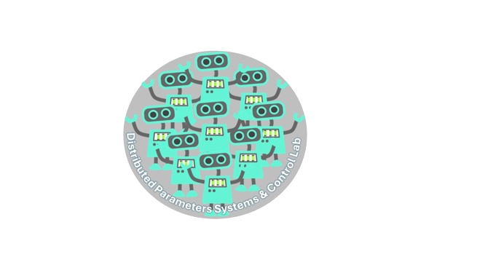


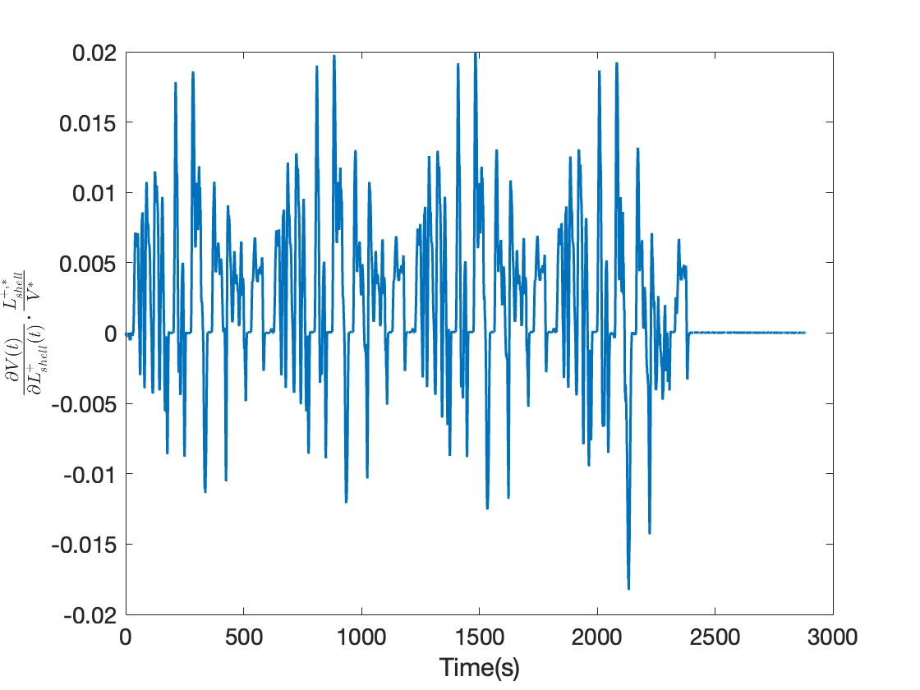
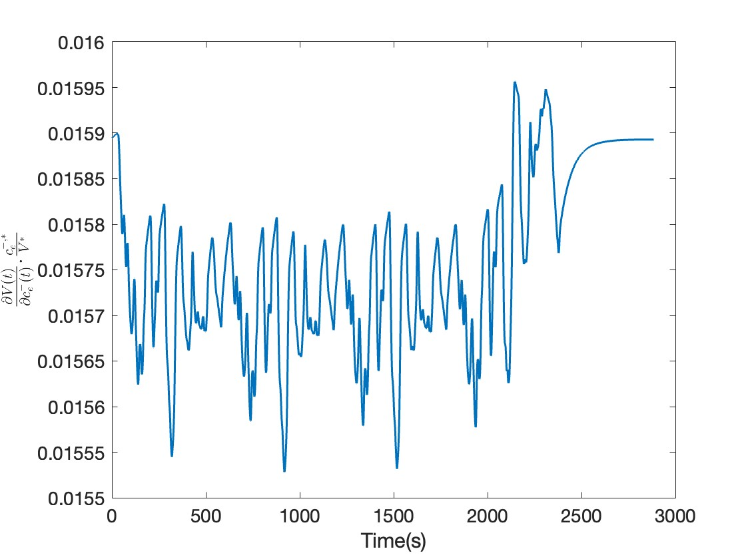
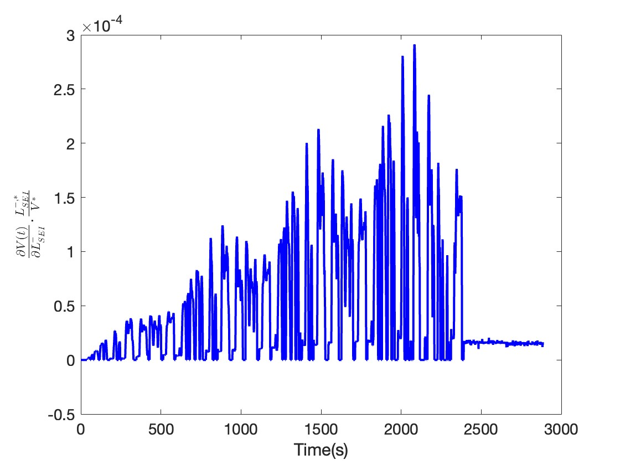
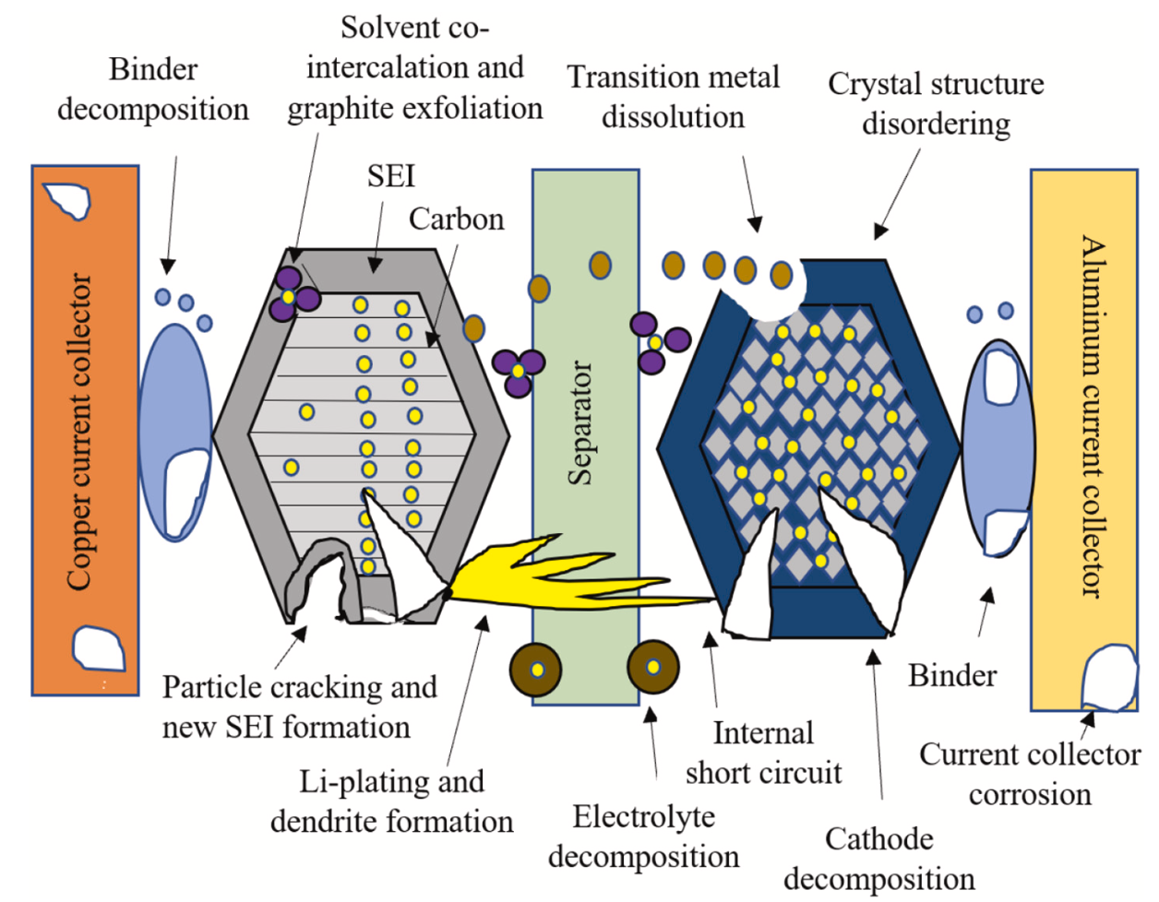
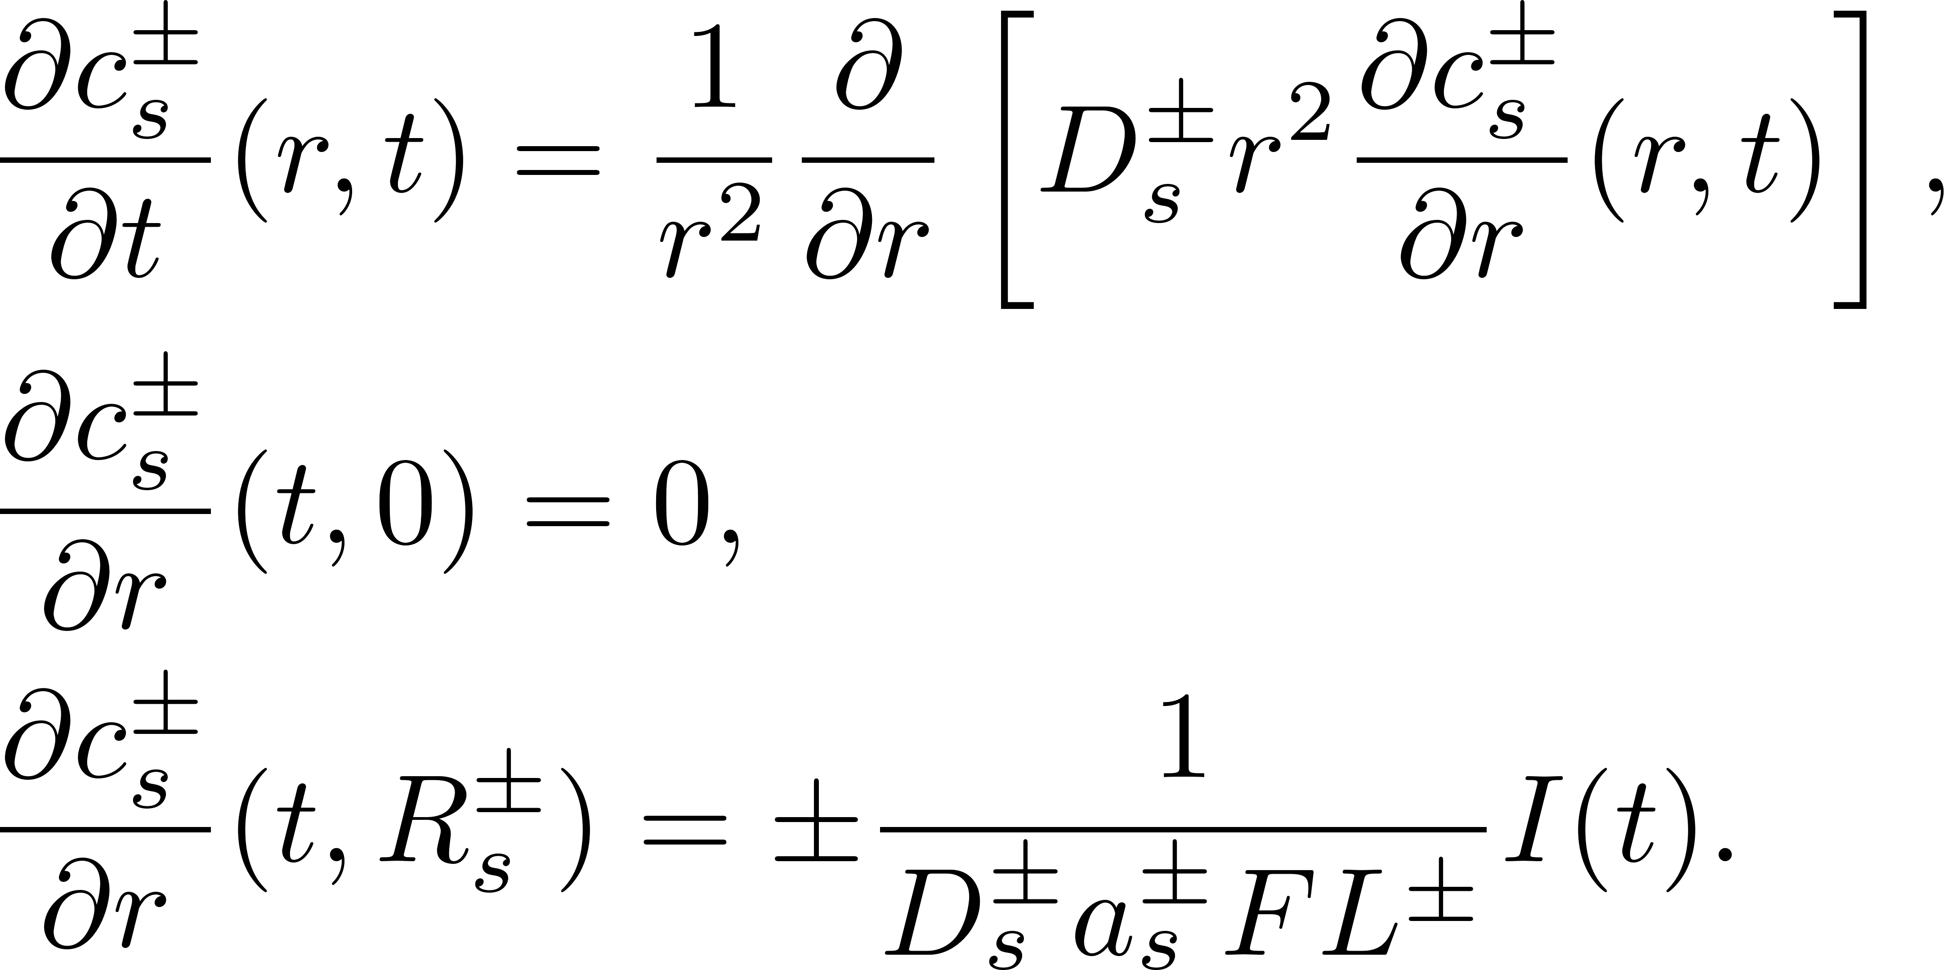
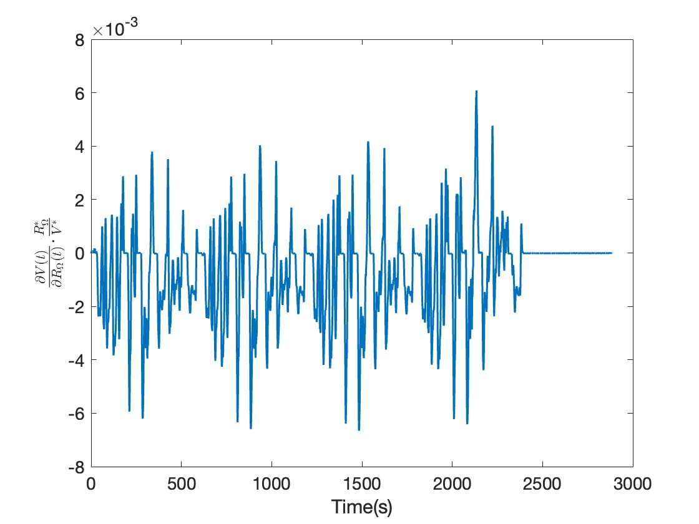
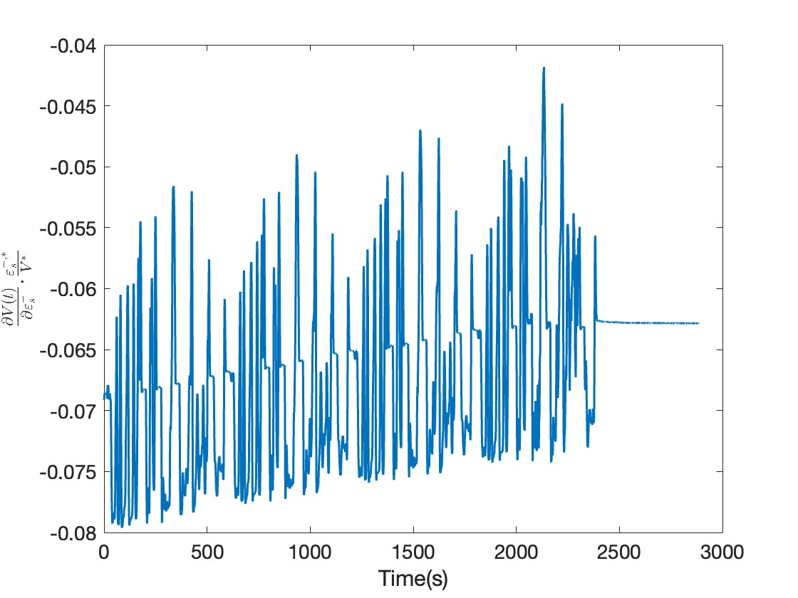
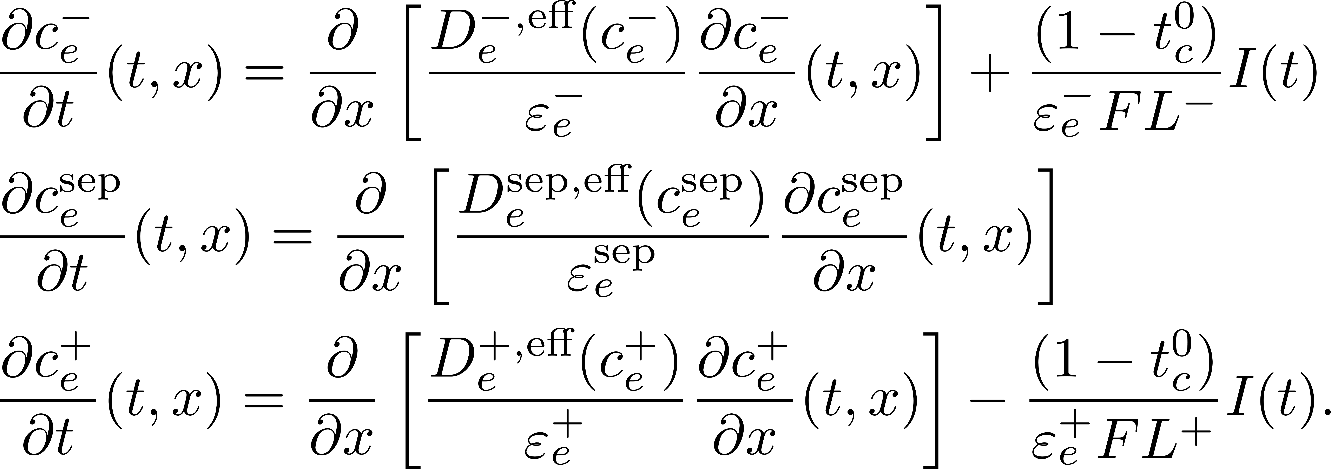
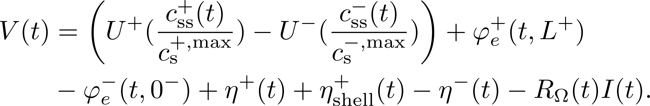
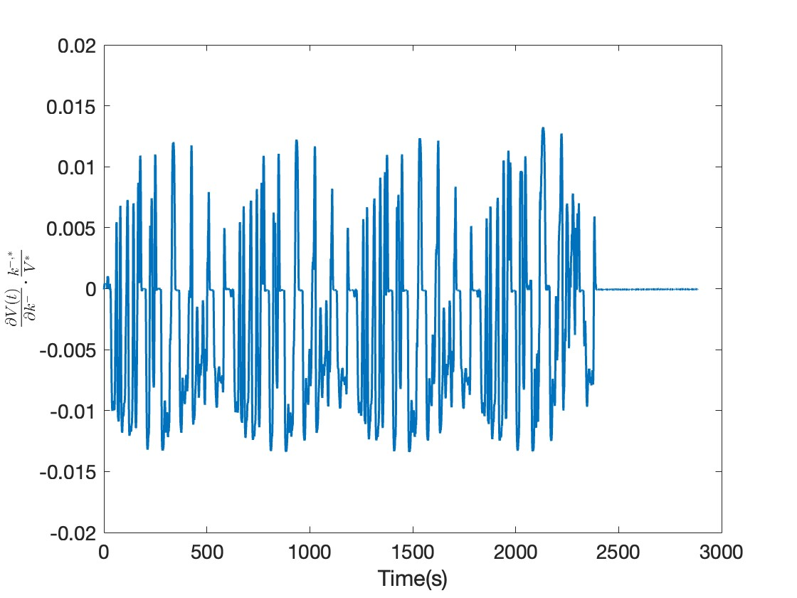
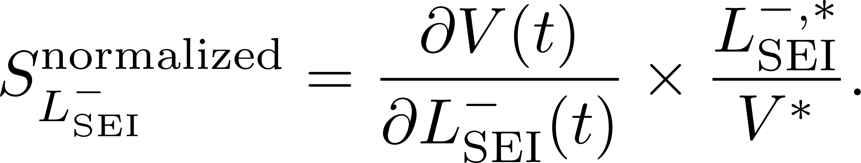


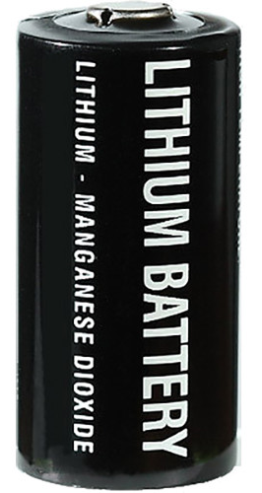

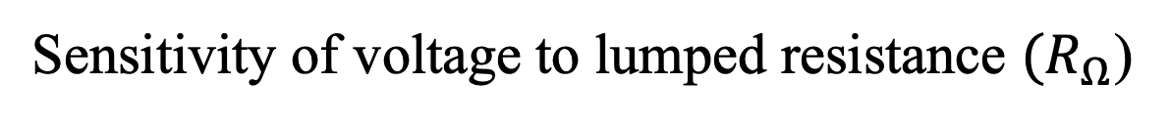




Analytical Sensitivity Analysis of Lithium-ion
Battery State-of-Health Indicators
Sara Sepasiahooyi and Shu-Xia Tang
ssepasia@ttu.edu, shuxia.tang@ttu.edu
Introduction
Model
The aging of lithium-ion batteries is complex, involving multiple State-of-Health (SoH). Sensitivity analysis of terminal voltage to these indicators provides insights into their contributions to the battery lifespan and performance.
Unlike most studies utilizing numerical methods, this work employs analytical derivation approach, which is more accurate and generic.
Capacity is the primary conventional SoH indicator in many studies. The sensitivity of voltage to capacity can only be analyzed numerically.
Battery Model:
Single Particle Model with electrolyte (SPMe) dynamics
$$Current of battery$$
$$\left(\text{Urban} \text{Dynamometer} \text{Driving} \text{Schedule} \text{(}UDDS) Profile \right)$$
$\text{Sensitivity} \text{of} \text{voltage}$ to shell resistance ${(R}_{shell}$)
SPMe Schematic
Solid-phase Li-ion concentration :
$$\text{Sensitivity} \text{of} \text{voltage} \text{to} \text{electrolyte} \text{lithium} \text{concentration}{ (c}_{e}^{−}(t,0^{−}))$$
$\text{Sensitivity} \text{of} \text{voltage}$ to SEI film thickness (L_{SEI})
Liquid-phase Li-ion concentration:
Courtesy: Vennam G, Sahoo A, Ahmed S. A survey on lithium-ion battery internal and external degradation modeling and state of health estimation. Journal of Energy Storage. 2022 Aug.
$\text{Sensitivity} \text{of} \text{voltage}$ to lumped resistance ${(R}_{Ω}$)
Terminal voltage:
Voltage of battery cell is $\text{more} \text{sensitive} \text{to}\text{: } c_{e}^{−}\left(t,0^{−}\right), ε_{s}^{−},k$
Method
$$\text{Sensitivity} \text{of} \text{voltage} \text{to} \text{volum} \text{fraction} \text{of} \text{active} \text{material}(ε_{s}^{−})$$
Conclusion &
Future Work
Analytical derivation and normalization:
(an example of sensitivity of voltage to SEI thickness)
Simulation
New SoH indicator vector:
electrodes cylindrical cell
Initial Capacity: 2700mAh
Temperature: T = 298 [K]
Initial stage of battery lifespan
Future works:
Additional SoH indicators
Simulation for entire battery lifespan
Simulation for other battery cells types
Performing numerical analysis and comparison
where * denotes the nominal value of the parameters.
$\text{Sensitivity} \text{of} \text{voltage}$ to reaction rate constant $(k^{−}$)
Reference: Sara Sepasiahooyi and Shu-Xia Tang, Sensitivity Analysis of Lithium-ion Battery SoH Indicators: An Analytical Study, American Control Conference, 2024, accepted.

